Slide 1


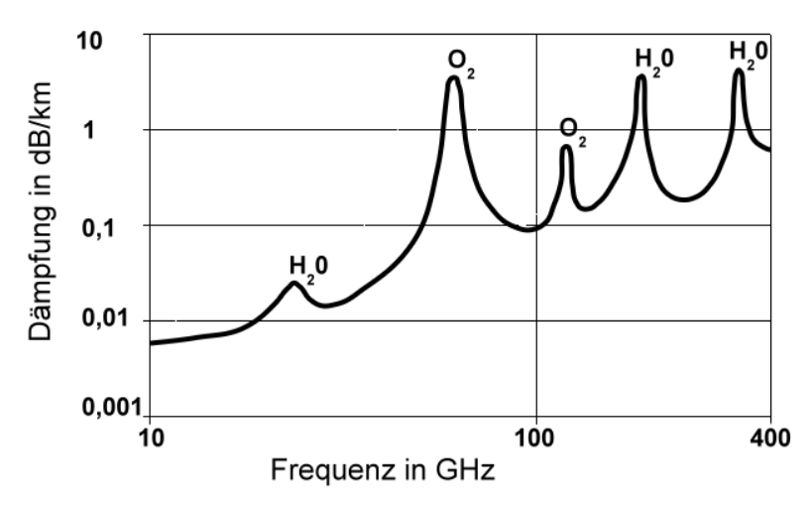
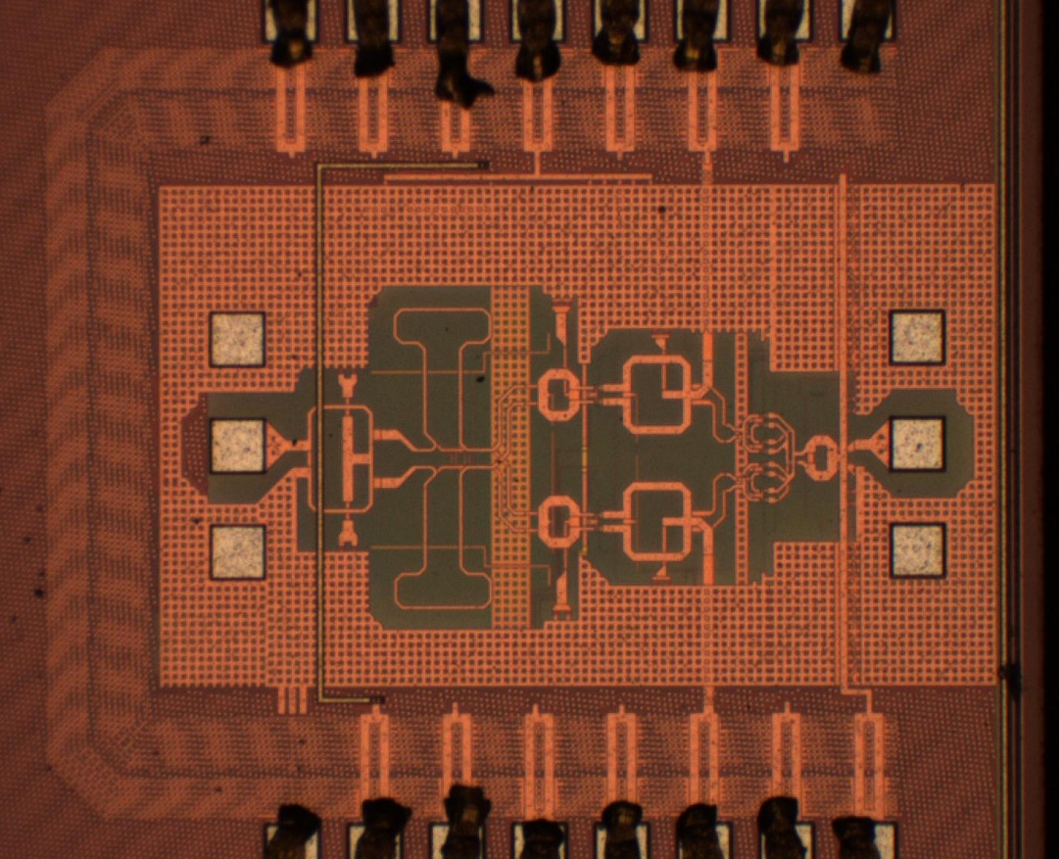
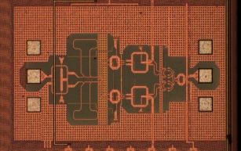
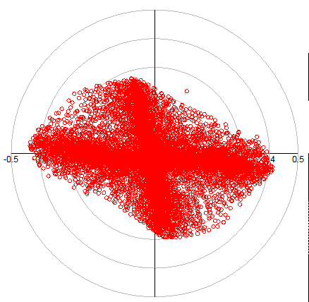
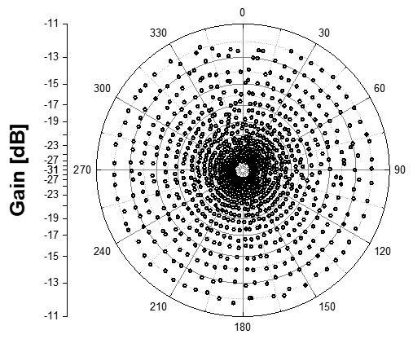
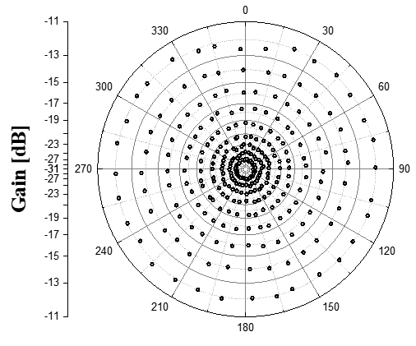
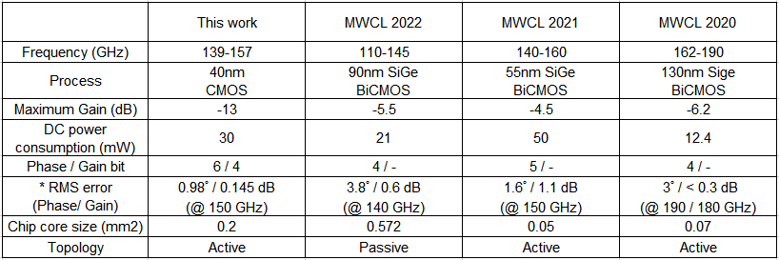
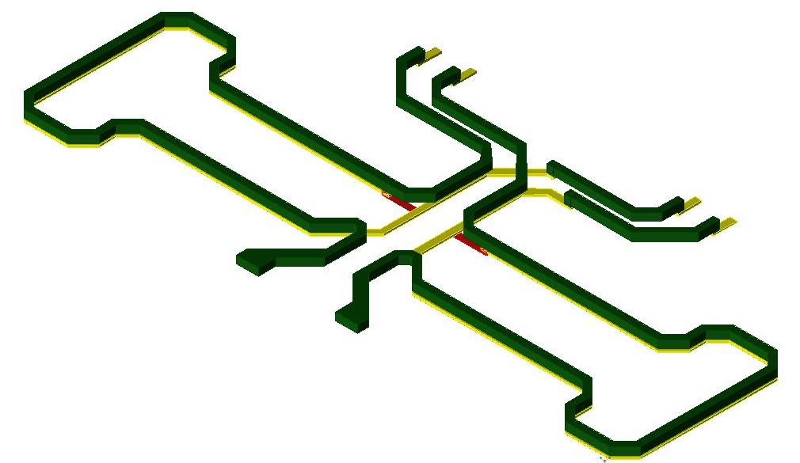
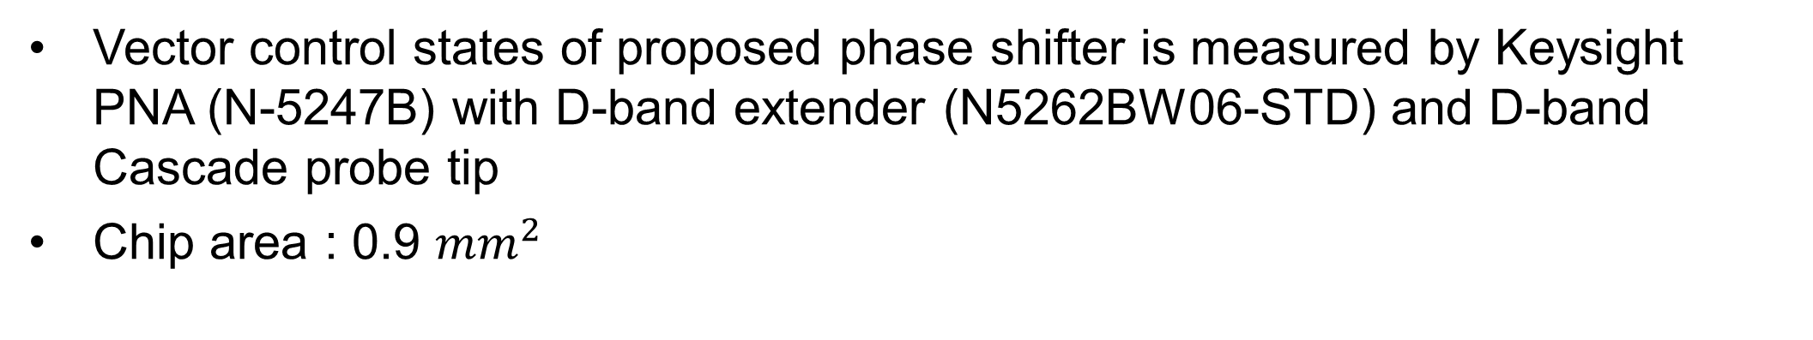
A Variable Gain Active Phase Shifter for D-band
with Low RMS Phase and Gain Errors
Yeonseung Kim and Songcheol Hong
School of Electrical Engineering, KAIST, Daejeon, Republic of Korea
Introduction
Chip Implementation and Measurement Results
Measurement set-up
Chip photograph
[ Attenuation factor in air ]
[ Phased array structure ]
Advantage of D-band frequency
Phase shifter is key-block for phased array
Low attenuation factor in air
Small area for phased array configuration (antenna distance ≈ 1/frequency)
The RMS error of a phase shifter has a direct impact on the accuracy of the beam pattern of a phased array structure
→ Low RMS error is important
Vector control states of proposed phase shifter is measured by Keysight PNA (N-5247B) with D-band extender (N5262BW06-STD) and D-band Cascade probe tip
Chip area : 0.9 ${mm}^{2}$
Schematic Design
Proposed phase shifter
Measurement results
Proposed phase shifter block diagram
Gilbert-cell based active phase shifter structure [1]
Hybrid coupler type IQ generator used
Phase(8bit), Gain(6bit) controlled by DAC
Short-channel transistor current source is used to cancel the channel length modulation effect [2]
Inter-stage VGA used for reduce IQ error
(a) Return loss
(b) Insertion loss
Proposed phase shifter schematic
[1] JSSC – 0.13𝜇m CMOS phase shifters for X-,Ku-, and K-band phased arrays
[2] TCAS-‖ – A W-band vector modulator using short-channel transistor current sources and impedance compensation varactors
Return loss : S11<-5dB / S22<-10dB (in D-band)
Minimum insertion loss : -13 dB (@150 GHz)
Phase / gain control DAC schematic
Phase control
DAC (+)
Gain control DAC
Phase control
DAC (-)
(c) Constellation – all bit
(phase-8bit / gain-6bit)
(d) Constellation - LUT
(phase-6bit / gain-4bit)
(e) Constellation - LUT
(phase-5bit / gain-3bit)
All phase and gain bits at 150GHz in Figure (c) are used to make the target vector by using the look-up-table (LUT) generation method [3]. The LUT generation results of phase-6bit, gain-4bit in Figure (d), and phase-5bit, gain-3bit in Figure (e).
RMS errors : (d) – phase:0.98˚,gain:0.145dB / (e) – phase:1.01˚,gain:0.15dB
Advantage of inter-stage VGA
Vector summer input impedance varies during vector control because vector summer MOSFET (M7-M14) operation region varies from off-state to saturation region, and if vector summer is directly connected to the quadrature generator, this variation induces the IQ error in the quadrature generator
→ Inter-stage VGA reduces IQ errors by preventing the effect of vector summer input
impedance change on the quadrature generator.
The commonly provided MOSFET modeling of the D-band is not accurate. This inaccuracy mainly effect the IQ gain error
→ Inter-stage VGA adjust each IQ path gain for reducing IQ gain mismatch
[3] MWCL – A 60-GHz polar vector modulator with lookup table-based calibration
Comparison table
IQ generator layout
IQ generator simulation results
* Best value in given frequency band
Conclusions
Hybrid coupler type IQ generator is optimized at 144 GHz.
The loss characteristic is -2 dB (ideal distribution loss 3 dB is excluded)
The phase difference characteristic is 87˚ (3˚ phase error)
A D-band variable gain phase shifter with low RMS phase and gain errors was implemented and verified. The proposed phase shifter has 6bit-phase and 4-bit gain controls with 2-bit calibration each. The phase shifter has 0.98˚ RMS phase error and 0.145 dB RMS gain error with these control bits. Especially compared with the D-band phase shifters, as in the comparison table, this work shows less RMS errors.
Acknowledgement
The chip fabrication and EDA tool were supported by the IC Design Education Center(IDEC), Korea.

